Slide 1
Credit Card Spend Prediction

Slide 2
Business problem/objective:
To predict the Credit card spent for a new customer given his details like demographics, personal details, card details etc.
This is a Regression problem where we would build a machine learning model to predict the Credit card spend of new customer.
Data Understanding:
Total number of variables : 130.
Target variables is derived as follows:
Total Spend = cardspent + card2spent
Algorithms used:
Decision Tree Regressor
XGBoost Regressor
KNN Regressor

Slide 3
Data Exploratory Analysis
There were insignificant variables and duplicate variables. So, dropped the following variables:
Categorical variable for numerical feature.
Log of a continuous feature.
Strong correlation between these numerical variables.
Doesn't help in building the model.
(i) (ii) (iii) (iv)
agecat
edcat
employcat
spousedcat
inccat
addresscat
cardtenurecat
card2tenurecat
lninc
lncreddebt
lnothdebt
lnlongmon
lnlongten
lntollmon
lnwireten
lntollten
lnequipmon
lnequipten
lncardmon
lncardten
lnwiremon
card2tenure
longten
custid

Slide 4
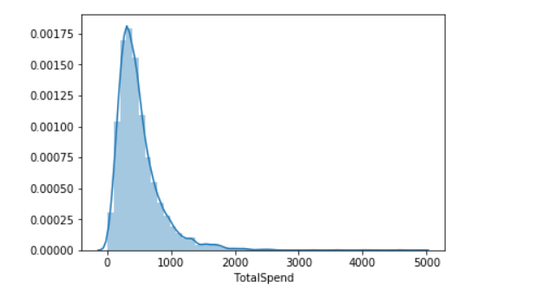
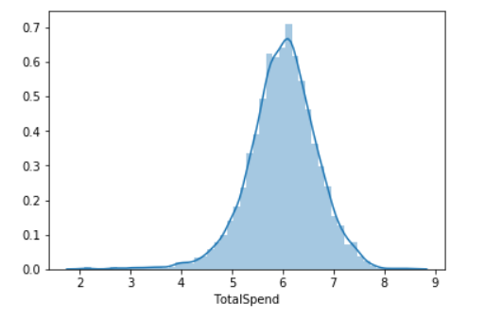
Distribution:
The Total Spend is not following normal distribution. So, transformation is needed to convert it into normal
distribution.
On applying log Transformation, log_TotalSpend follows normal distribution. So, log_TotalSpend will be used as Target.

Slide 5
Outlier Treatment:
UC: 0.99 quartile
LC: 0.01 quartile
All the points less than LC and greater than UC is considered as an outlier and removed.
Missing Treatment:
For numerical variables: Replace the missing values by the mean of the variable.
For categorical variables: Replace the missing values by the mode of the variable.

Slide 6
Feature Engineering:
Variable Reduction:
Applied Correlation between numerical variables and log_TotalSpend variable.
22 numerical variables have been dropped because of very low value of correlation with the target variable.
10 numerical variables have been selected for further model building processes.
Performed ANOVA between Target and each categorical variables:
34 categorical variables have been dropped because of p value less than 0.05.
37 categorical variables have been chosen for further steps.
Dummy Variable Creation:
36 categorical variables are one-hot encoded to generate dummy variables.
1 ordinal variable is used as it is.
62 new categorical variables are created using dummy variable creation.
Total 63 categorical variables are chosen for further steps.

Slide 7
Variable Selection:
SelectKBest
Selected 15 most important variables from the total 73 variables.
Recursive Feature Elimination
Selected 15 most important variables from the total 73 variables.
F- Regression
Selected most important variables with p value < 0.05.
Variation Inflation Factor
Consolidated all the selected variables from above 3 steps and applied VIF.
Selected top 20 variables with vif < 5.
Linear Regression
Built a ols regression model.
Removed the least contributing variables based on p value.
Selected 14 variables for the final model building.

Slide 8
Model pre-requisites/ Model Assumptions:
The Target variable (Total Spend) follows normal distribution.
Outliers have been removed.
No missing values in the data.
Categorical variables have been properly encoded.
Selected < 15 variables for final model building based on reduction techniques.
No multi-collinearity between X variables.
Train and Test split:
Train data = 70 %
Test data = 30 %
Train data will be used to build the model.
Test data will be used to validate the model.

Slide 9
Goodness of fit metrics:
Based on the above metrics, XGBoost Regressor is the best model.

Slide 10
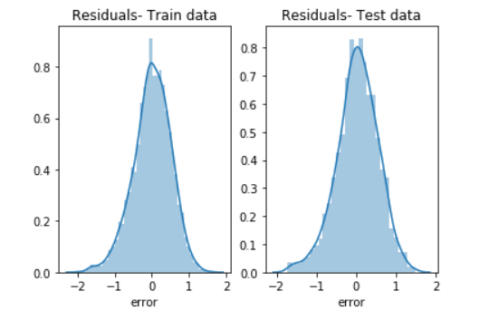
Residual Analysis:
For all 3 models, the residuals follow normal distribution as expected.
For XGBoost Regressor Model

Slide 11
Rules and Metrics:
Transformation of y-variable (TotalSpend) to log_TotalSpend. It is important in regression to have the target variable follow normal distribution.
Removal of duplicate variables like log(numerical variables) etc.
Remove the outliers in the data. Outliers will significantly affect the model parameters.
Replace the missing values in data using mean for numerical variables and using mode for categorical variables.
Select best numerical and categorical variables using correlation and ANOVA respectively.
Select important features using SelectKBest, RFE, F-Regression etc.
Use VIF to remove multi-collinearity between features. Presence of multi-collinearity will significantly affect the model.
Use GridSearchCV to tune the parameters to obtain the best model.
Use metrics like R2, RMSE, MAPE, RMSPE to identify the best model.
R2 should be high
RMSE, MAPE, RMSPE should be low.
The decile analysis should show that actual and predicted values have similar values.

Slide 12
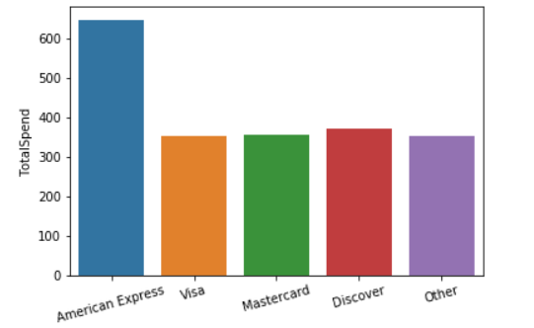
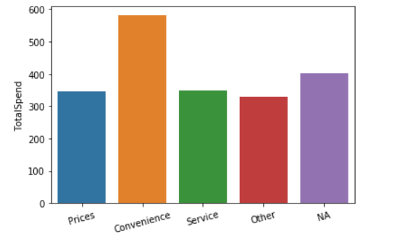
Key Drivers:
XGBoost Regressor (Best model)
Income: Income feature is the most significant variable in determining the credit card spend. If income is more, the credit card spend is also more. It is a positive driver.
Card: The type of primary credit card play a major influence in the credit card spend. Analysis shows that ‘American Express’ credit card type has more spend.
Reason: The analysis shows that customers who primarily chose to be a customer here due to ‘Convenience’ has more spend than customers with other reasons.

Slide 13
Business Outcome:
Given the attributes of a new customer, the XGBoost Regressor model will predict the log of Total credit card spend of the customer. Upon taking the exponential of this value, the possible credit card spend is obtained.
Based on the predicted spend, the bank can decide the credit limit for each customer.
Identified income, primary credit card type and reason as the key drivers affecting the credit card spend of the customers.

Slide 14
Pros of model:
Few variables used in the final model building, ensures no overfitting.
Relatively low values of RMSE, MAPE etc.
Cons of model:
If the income input is not accurate, the model output becomes unreliable.
Needs to rebuild the model if a new customer attribute is added.
Recommendations & next steps:
The model can be trained using much bigger dataset to improve the metrics.

Slide 15
Implementation tool based on final XGBoost model:
Collect the data for a new customer.
Apply outlier treatment using the cut off used while building the model.
Replace the missing values in the new data using the same data used for replacing missing values during model building.
Apply all the transformations that had been applied on the train model on the new data as well.
Obtain the values of the 14 features required for the model.
The final model is saved as a pickle object.
Load the pickle object and predict for the new customer data. The output will be in log(TotalSpend).
Apply exponential to the above output to obtain the actual predicted Credit Card Spend for the new customer.

